Slide 1
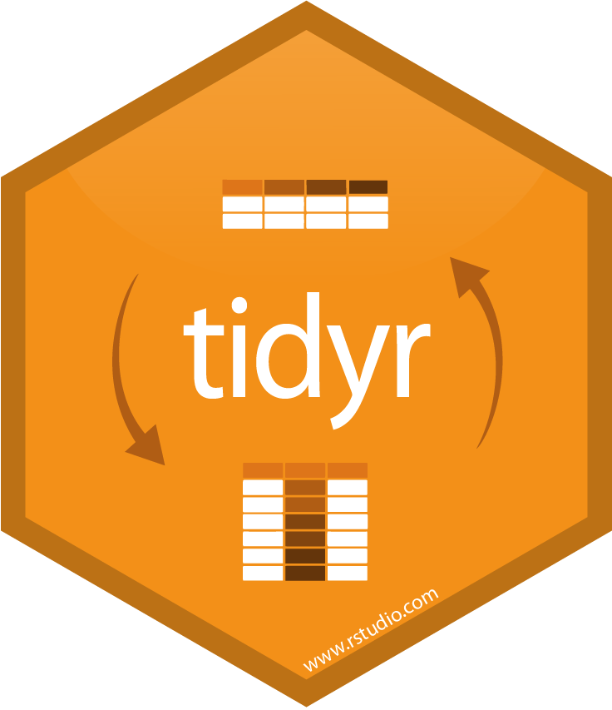








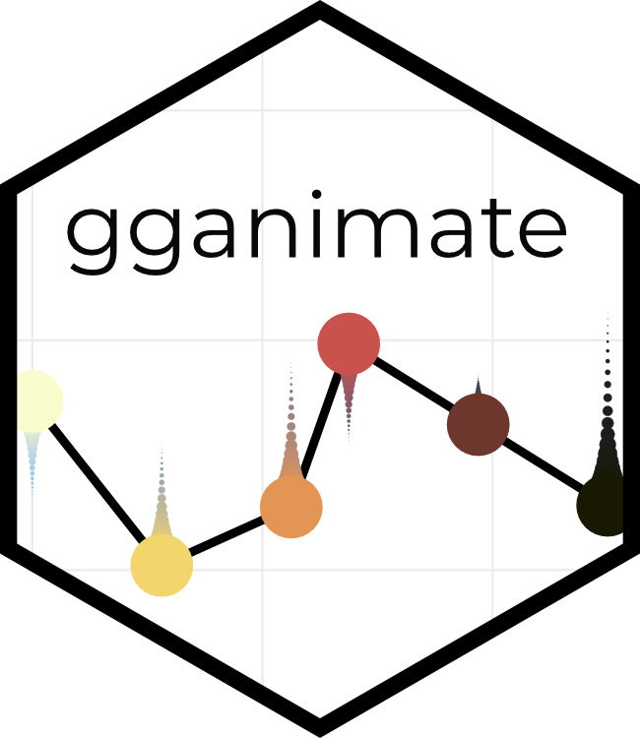











IMPORT DATA
DATA AGGREGATION
TIDY & WRANGLE DATA
AFTER DATA
CRAWLING
DATA AGGREGATION P2
VISUALISATION PREPERATION
DATA
PROCESSING
TIDY & WRANGLE DATA P2
APPLICATION
TIDY & WRANGLE DATA P3
VISUALISATION
COMMUNICATION
& IDE
TMAP
& MANY MORE PACKAGES

